Slide 1
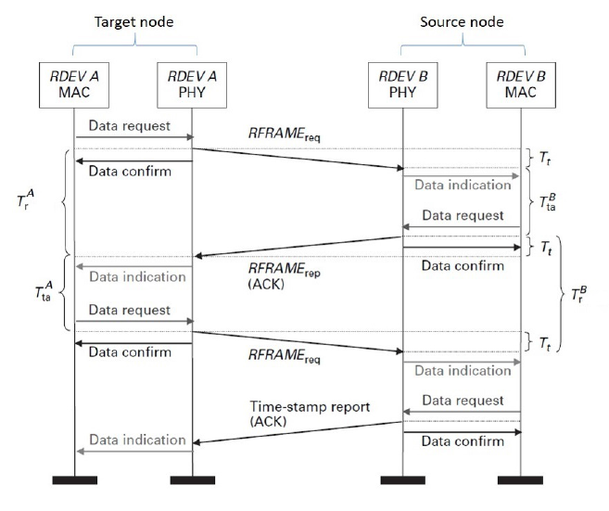
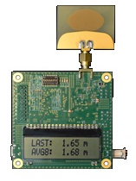
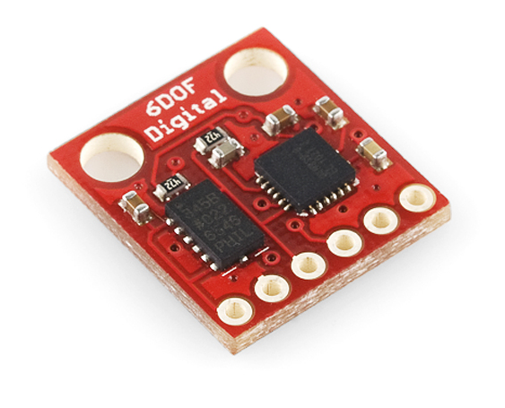
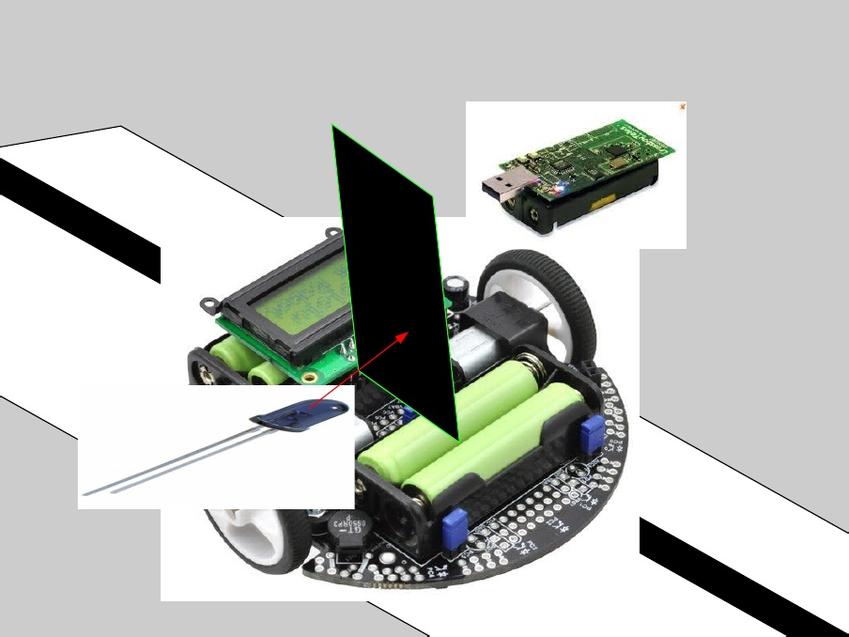



Ultra WideBand (UWB) real time positioning
Mohammadreza Yavari and Bradford G. Nickerson
University of New Brunswick, Faculty of Computer Science
Motivation:
Growth of applications depending on position information.
UWB can provide inexpensive, wireless, indoor positioning with decimeter precision.
IEEE 802.15.4-2011 standard is a solid base for widespread real-time location services.
UWB positioning systems lose accuracy in non line of sight (NLOS) conditions.
Ranging protocol
Technology
www.sparkfun.com
Decawave EVK100 evaluation kit.
Accuracy in LOS : 10 cm
IEEE 802.15.4-2011 compliant
Range : up to 290 m
Dimension : 7 cm by 7 cm
Communication rate : 6.8 Mb/s
Inertial Navigation Unit (IMU) Digital Combo Board - 6 Degrees of Freedom
Gyroscope : ITG3200
Accelerometer : ADXL345
Dimension : 1.52 cm by 1.65 cm
Methodology
Line follower robot with infrared (IR) blocker plate detects actual position in real time.
IEEE 802.15.4-2011, SDS-TW-TOA ranging protocol¹
Objectives
System architecture
How much is the accuracy of Decawave UWB positioning in LOS/NLOS condition?
Is it possible to have a communication channel simultaneous with positioning? If yes, how much is the maximum communication rate?
How much can NLOS error be mitigated by methods proposed in
the literature?
How much can inertial measurement unit (IMU) and Kalman filter increase the LOS/NLOS accuracy of UWB systems ?
What is the minimum number and arrangement of UWB base stations required for accurate positioning, and how does one find this?
UWB system
NLOS error mitigation
Range Estimate
INS system
Acceleration
Kalman Filter
Position
Orientation
Feedback
1- I. G. Zafer Sahinoglu, Sinan Gezici. Ultra-wideband Positioning Systems: Theoretical
Limits, Ranging Algorithms, and Protocols

